Slide 1
Fuel Efficiency,
In-Cylindrical Pressure &
HRR Prediction

Slide 2
Abstract
We have 20 + Fuels and its combination of Fuels.We are going to find which combination of amount of fuel gives best Efficiency with Several Loads such as 5.2 Brake Power,4.16,3.12,2.08,1.04 .Our parent Fuel is CNSL(Cashew Nut Shell Oil) combined with other Fuels like Diesel.Methanol etc.

Slide 3
Introduction
Identify the best fuel Efficiency
In Cylindrical Pressure for 720 angles
Heat Release Rate Prediction.
we have 20 + Fuels and its combination of Fuels.
Find which combination of amount of fuel gives best Efficiency with Several Loads such as 5.2 Brake Power,4.16,3.12,2.08,1.04 .

Slide 4
Motivation
Meet both the ends of the most practical energy conversion device.
One side is diesel engines is needed in various sectors like industry and transport since its most reliable.
Other side we have biofuels that are on par with diesel but they have some drawbacks if directly used.
Through this project we can find which fuel combination at which load give best performance.
Since Mechanical engineers don't know ML and Data Analytics difficult for them to work with huge datasets and precision.

Slide 5
Literature Survey

Slide 6
PAPER | YEAR | AUTHORS | RESULT
FUEL EFFICIENCY PREDICTION | 2022 JETIR | M. Aditya Vamsi, B. Raja Rishita, M. Amin Qurishi, N. Siva Sandeep, K. Raghu Ram | Upon comparing and testing all the models, we found that Decision tree is the most efficient one among all the models with an accuracy of 99.9%.
Fuel Consumption Prediction Model using Machine Learning | 2021 IJACSA | Mohamed A. HAMED, Mohammed H.Khafagy, Rasha M.Badry | The value of the R-Squared/R2 metric is 0.96 for the Original VS_MAF.Diagnostics Dataset. Results achieved a higher accuracy with an R-Squared metric value of 0.97 than other related work using the same Support Vector Machine regression algorithm.
Vehicle Fuel Consumption Prediction | 2020 | Ying Yao,Xiaohua Zhao ,Chang Liu , Jian Rong,Yunlong Zhang,Zhenning Dong ,and Yuelong Su | fuel consumption prediction models based on a BP neural network, SVR, and a random forest were constructed. results of model error and the run time comparison analysis show that the three models could predict fuel consumption accurately, and the random forest model had the highest accuracy and efficiency, with an RMSE of 0.783 L/100 km, mean absolute percentage error (K) of 6.9%,

Slide 7
Challenges
Challenges of Underfitting:
Insufficient model complexity leads to oversimplified representations.
Fails to capture underlying patterns and nuances in the data.
Inability to adapt to dataset intricacies, resulting in poor performance.
Accurate Result:
Hindered by the risk of underfitting.
Model lacks the capacity to accurately represent true data relationships.
Algorithm Not Properly Fitted:
Inadequate model complexity hampers capturing dataset intricacies.
Reduced capacity to learn from the data, resulting in suboptimal performance.

Slide 8
Objective
Identify the best fuel Efficiency,In Cylindrical Pressure for 720 angles and Heat Release Rate Prediction.
We intend to achieve this by using formula method and Machine Learning algorithms and visualization.

Slide 9
Innovation:
Project will predict behaviours/performance of diesel engine when filled with various combinations of biofuels
Therefore it saves time and money spent on testing engine with biofuels.
This will finally help in saving the harmful pollution elements released by the automobiles in the air.

Slide 10
Scope:
Since the results would be comparable with practically obtained results i.e experimental result.
Hence we can rely on result and go for actual experiment with best performing point saving the time and money.
These results can be used for validation since the precision rate would be higher.

Slide 11
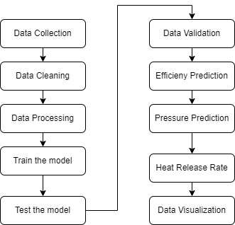
Working Process

Slide 12
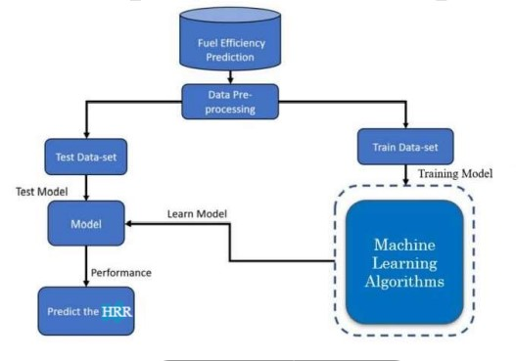
Architecture Diagram

Slide 13
Algorithm Used
Random Forest regressor
Linear Regression
Decision Tree
Gradient Boost Regressor
We implement the algorithm that best accuracy and less error for further prediction.

Slide 14
Explanation
The models considered in our analysis include:
1. Multiple Linear Regression:
a straightforward approach to modeling the relationship between multiple independent variables and a dependent variable.
a suitable choice for our multi-factor analysis of in-cylinder pressure.
2. Random Forest Regressor:
ability to handle complex relationships in data.
capable of capturing non-linear patterns and interactions between factors

Slide 15
Explanation
3. Decision Tree Regressor:
effective model for regression tasks.
decision tree regressors performed well in capturing the impact of various factors on in-cylinder pressure.
4. Gradient Boosting Regressor:
combines the predictions of multiple weak learners to create a strong predictive model.
known for their high accuracy in regression tasks.

Slide 16
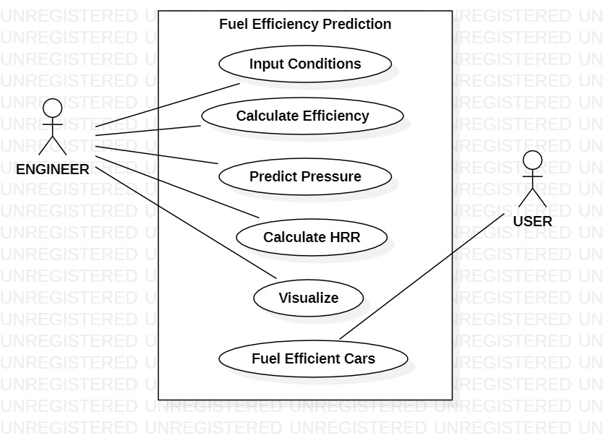
Use Case Diagram

Slide 17
DEEP LEARNING :
Model: Artifical Neural Network
ANNs are widely used in various fields, including computer vision, natural language processing, speech recognition, and finance, among others. They excel at tasks such as classification, regression, pattern recognition, and function approximation.
Limitation:
Due to the limited dataset size, the deep learning model struggled to make accurate predictions, failing to capture the intricate patterns present in the data.

Slide 18
Specific Fuel consumption :
Definition of Fuel Consumption: Fuel consumption refers to the rate at which fuel is used by an engine during operation. It is typically measured in units like liters per hour or gallons per mile.
Fuel Mass: The mass of fuel consumed by the engine is determined by the amount of fuel burned during a certain period of operation. This mass is typically measured in kilograms or pounds.
Power Output: Power output of an engine refers to the amount of work it can perform per unit of time. It's usually measured in units like horsepower (hp) or kilowatts (kW).
Inverse Relationship: There's an inverse relationship between fuel consumption and power output. As the power output of the engine increases, the fuel consumption typically decreases, and vice versa.

Slide 19
Efficiency Consideration: While higher power output generally means lower fuel consumption per unit of work done, it's essential to consider the efficiency of the engine. Some engines might have higher power outputs but lower efficiency, leading to higher fuel consumption overall.
Optimization: Engineers aim to optimize engine design and operation to achieve the desired balance between power output and fuel consumption. This optimization involves factors like combustion efficiency, engine design, and fuel type.
Variability: Fuel consumption can vary based on several factors, including engine load, speed, temperature, altitude, and driving conditions. These variables affect the efficiency of fuel combustion and, consequently, the amount of fuel consumed per unit of power output.

Slide 20
Thank You
MADE BY:-
DIKCHA SINGH (RA2011027010096)
K SANTHANA LAKSHMI (RA2011027010129)

